Slide 1
API with Postman
How to call API manually in Postman
By Hoang.Vu

Slide 2
Agenda
 | Postman Overview
 | Create API request in Postman
 | Environment Variables in Postman
 | Export & Import Collections
 | Q & A
1
2
3
4
5

Slide 3
Postman Overview
01

Slide 4

Postman overview
Postman is an API platform for building and using APIs.
Ability to make various types of HTTP requests like GET, POST, PUT, DELETE.
Support as Chrome extension.

Slide 5
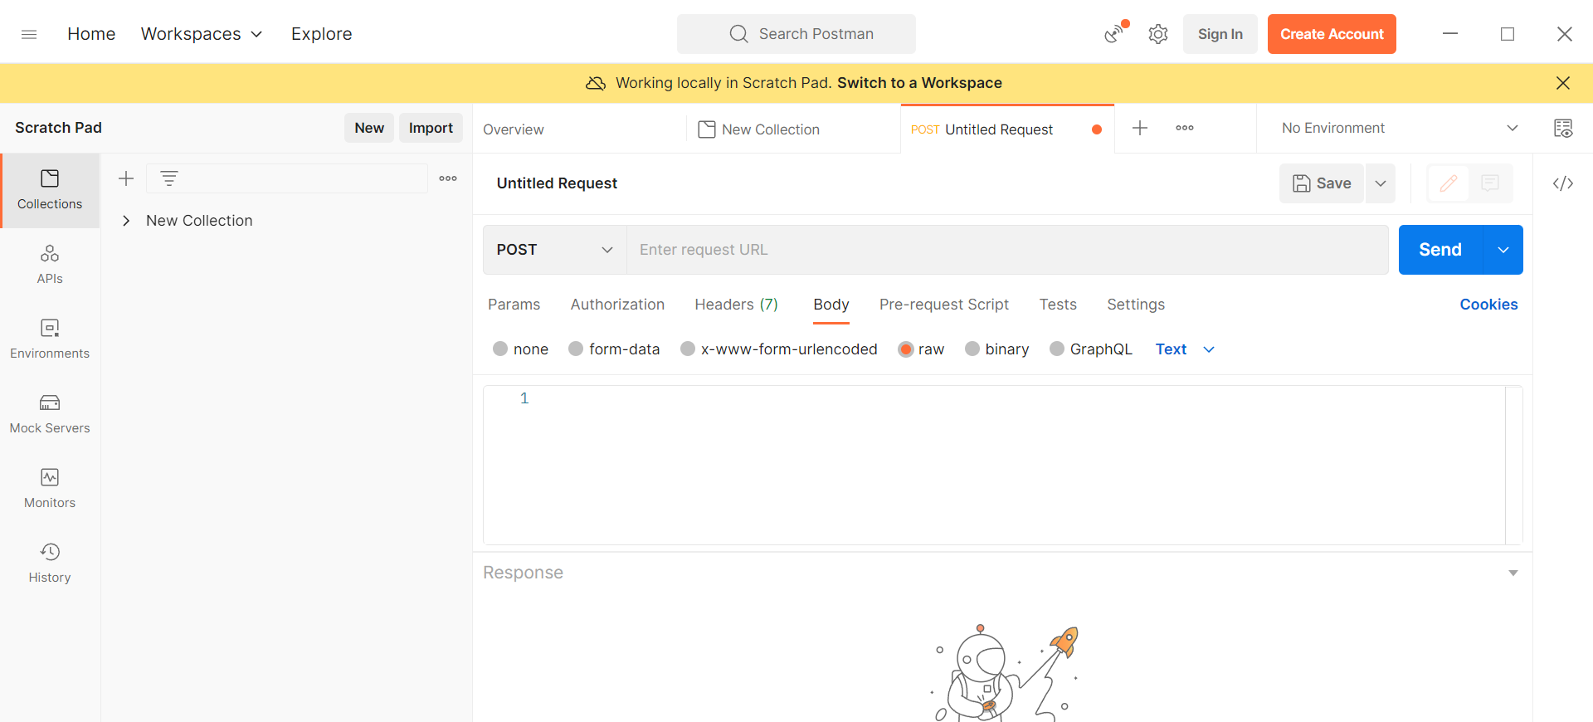
Postman overview

Slide 6
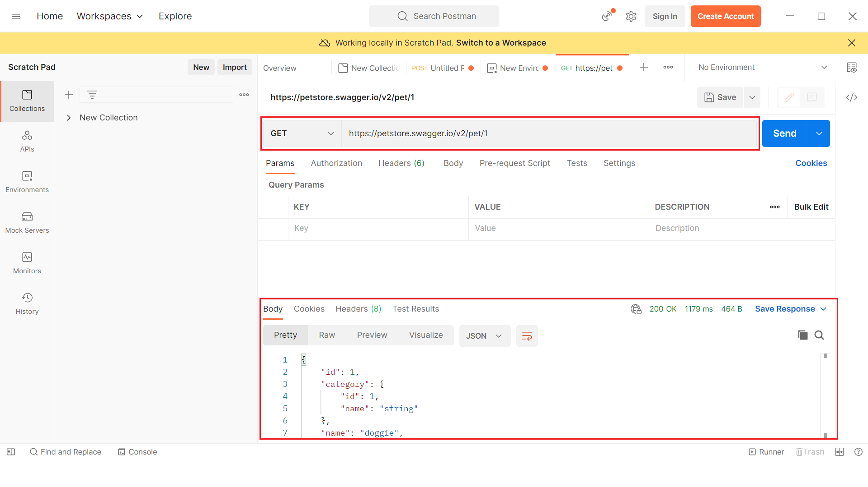
Create a request in Postman

Slide 7
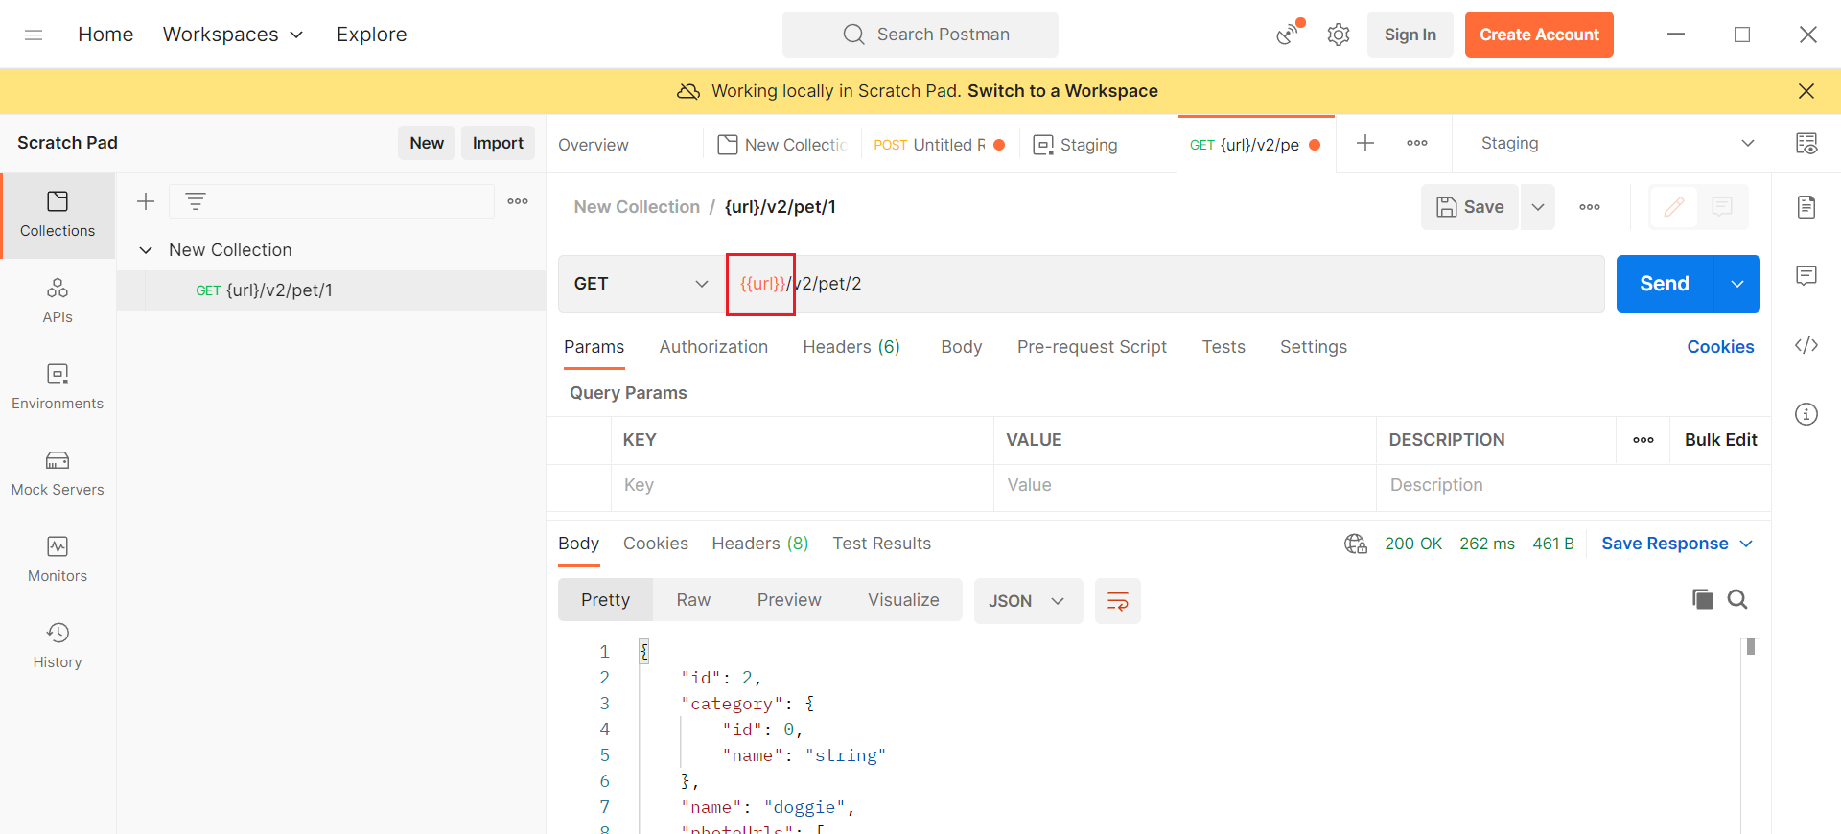
Environment variables in Postman

Slide 8
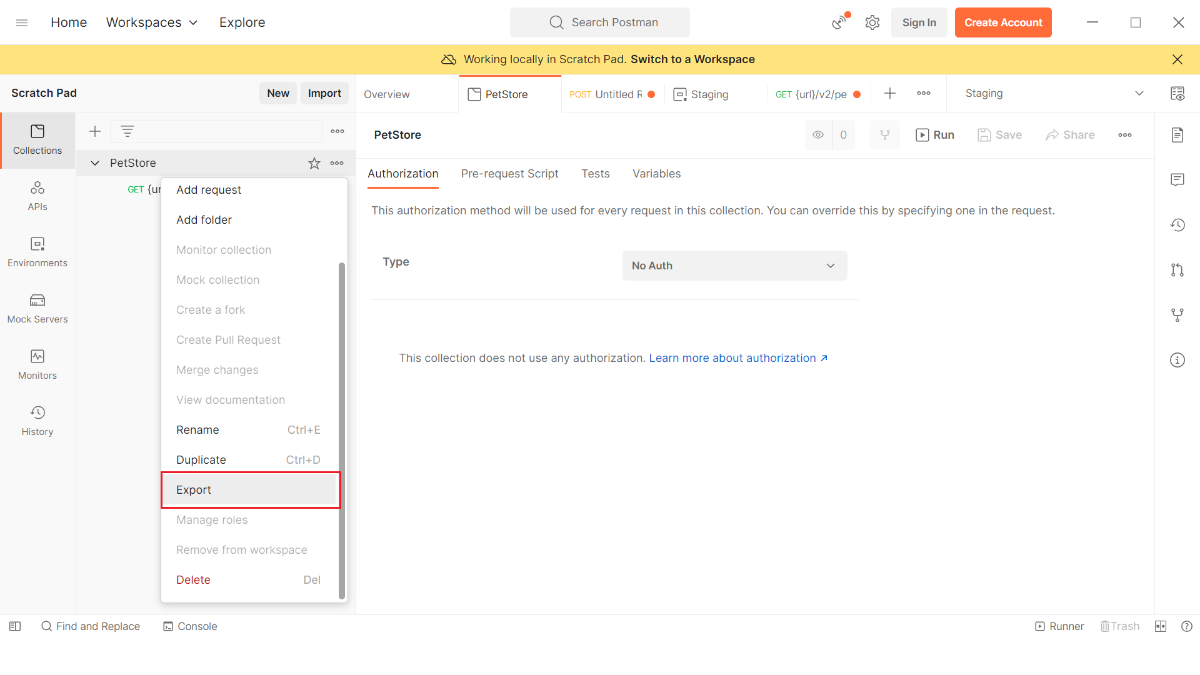
Import & Export in Postman

Slide 9

Q&A

